Slide 1

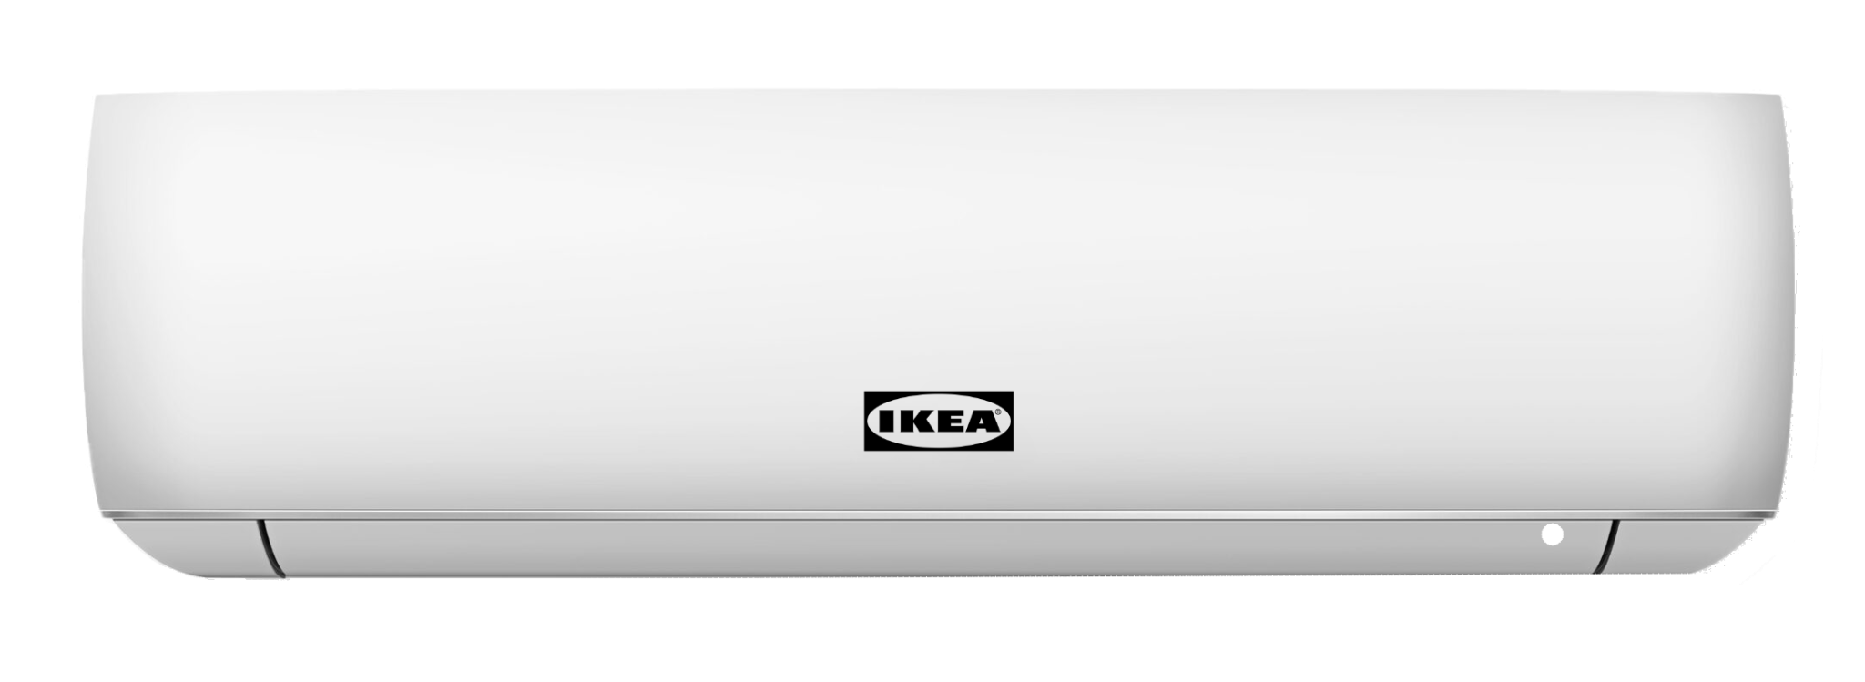
Luftig
TEK830 Digitalization and AI in practice
The smart AC for your smart home

Slide 2
What problem are we solving?
~90% of US Households have an AC
~27% of US Households struggle with electricity bills
AC’s cause ~19% of US Households energy consumption

Slide 3
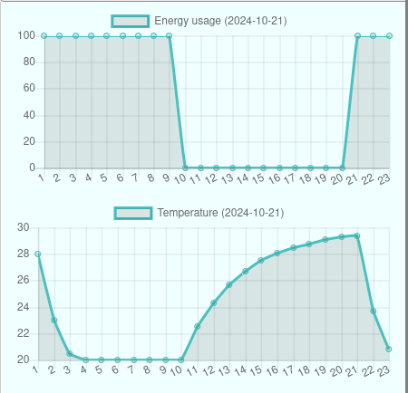
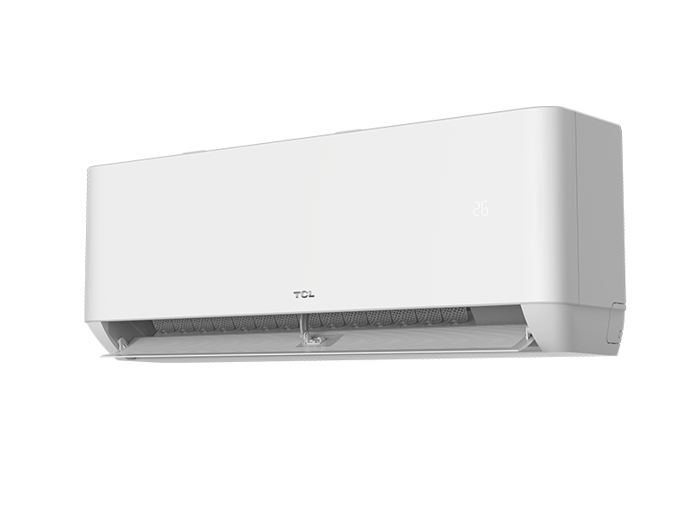




A day in the life of our customer
Home

Slide 4
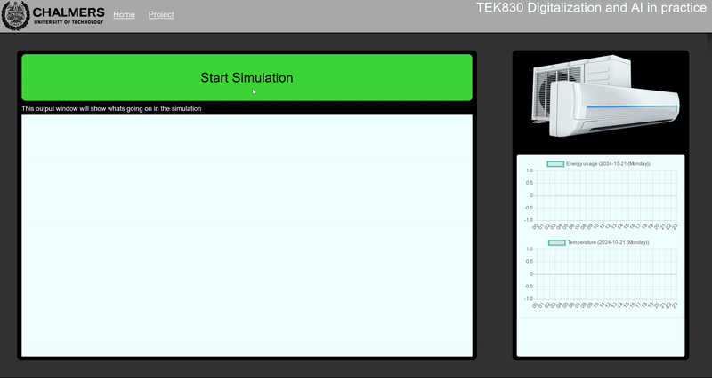
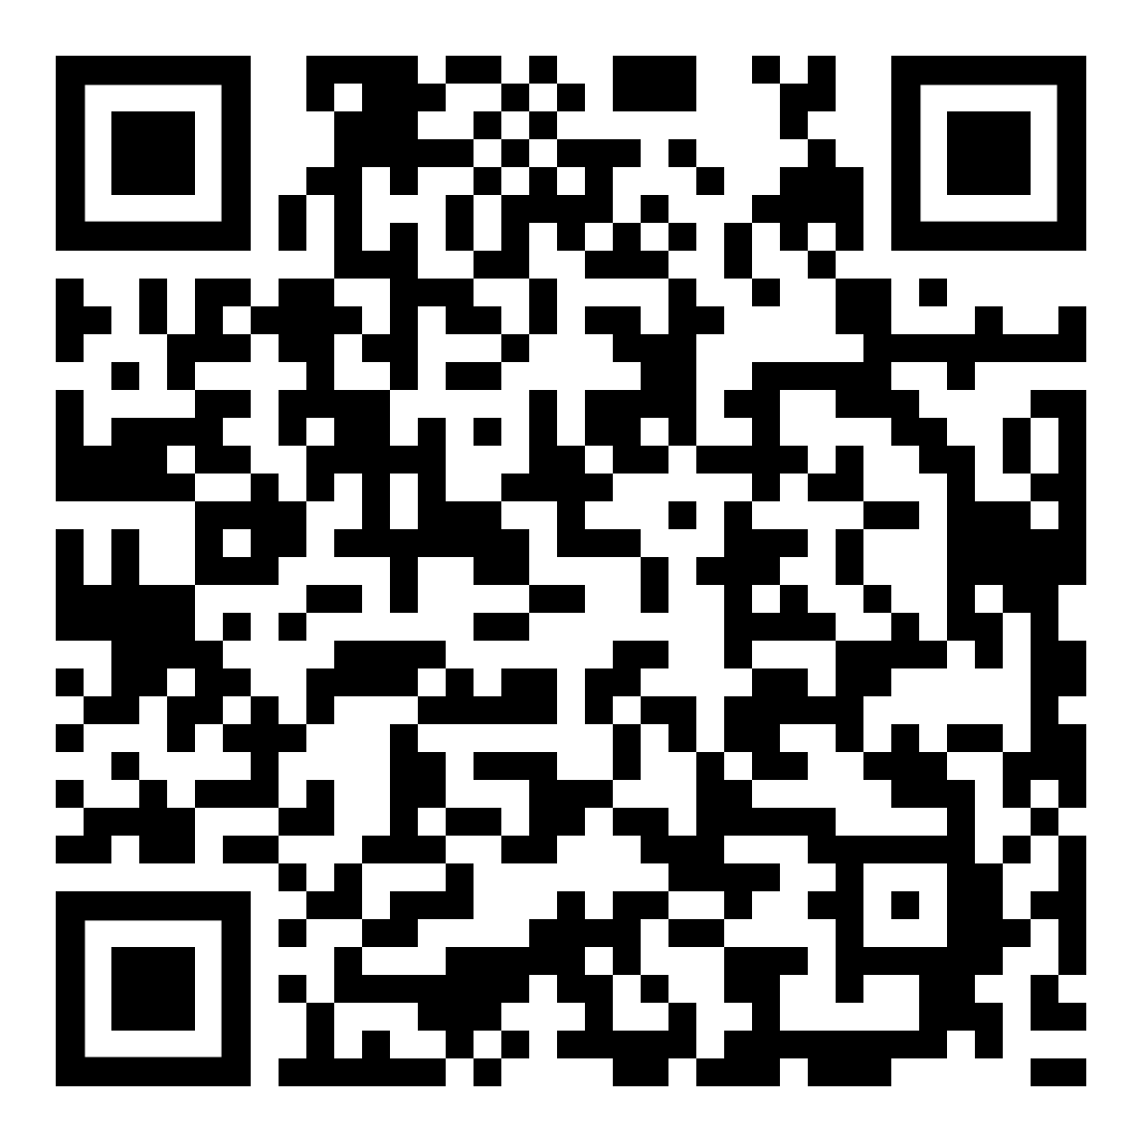
Project Prototype

Slide 5
The project going forward

Slide 6
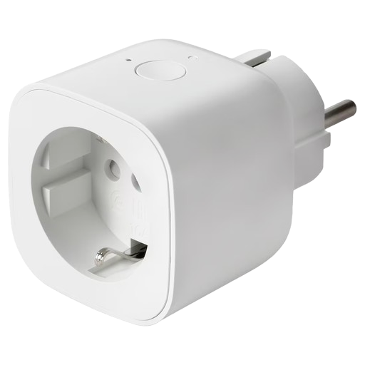

Scalability
The smart plug solution
Scale with other manufacturers

Slide 7

Testability
Simulations
Testing using a normal AC and real users

Slide 8

The Algorithm
Solving irregular days and events
Machine learning algorithms

Slide 9

Security
Third Party partners
Data Security for our Customers

Slide 10
Thank you!
TEK830 Digitalization and AI in practice
The Team
Isac Snecker (snecker@chalmers.se) cid: snecker
Isac Jason (isacjas@chalmers.se) cid: isacjas
Isak Söderlind (isak.o.soderlind@gmail.com) cid: isaksode
Jakob Schüldt (jakobschyldt@gmail.com) cid: jakobsch
Emil Svensjö (ema.svensjo@gmail.com) cid: svensjoe
Jonatan Cederberg(joncedwarframe@gmail.com) cid: jonceder
Innovation Website
Sources
https://www.theatlantic.com/newsletters/archive/2024/06/america-the-air-conditioned/678732/ (Article on Americans AC usage)
https://www.eia.gov/tools/faqs/faq.php?id=1174&t=1 (Article on Americans AC usage)
https://michigansaves.org/news/how-to-cut-your-energy-bill-using-the-information-on-it/ (Images)
www.istockphoto.com (Images)
Online video interviews with Americans.

